Slide 1
Team 64 Chess Game
Jean-Michel Guerin
Pranay Raj Kapoor
Michael Triglia
**NOTE: Best to view in Windows OS to see all graphics

Slide 2
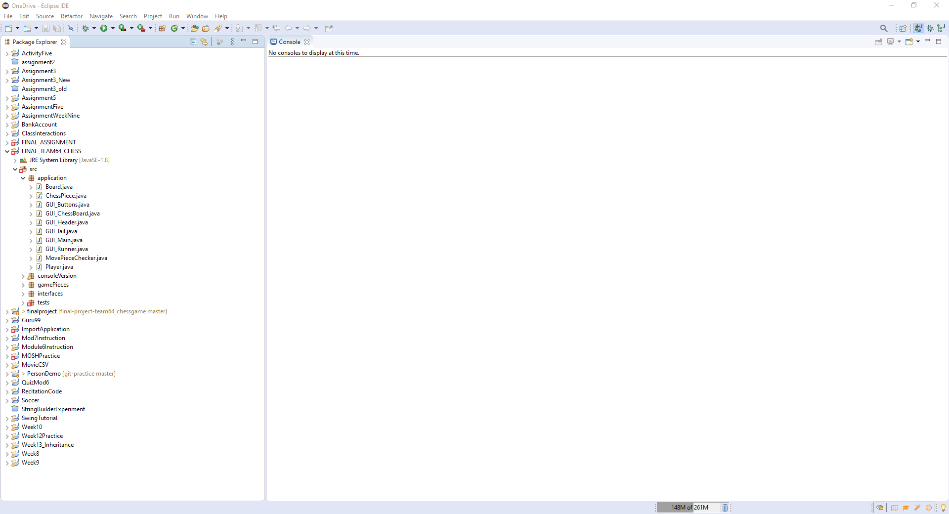
Once in IDE from GitHub (UPenn-CIT599 / final-project-team64_chessgame)
Within application package, click “GUI_Runner.java”

Slide 3
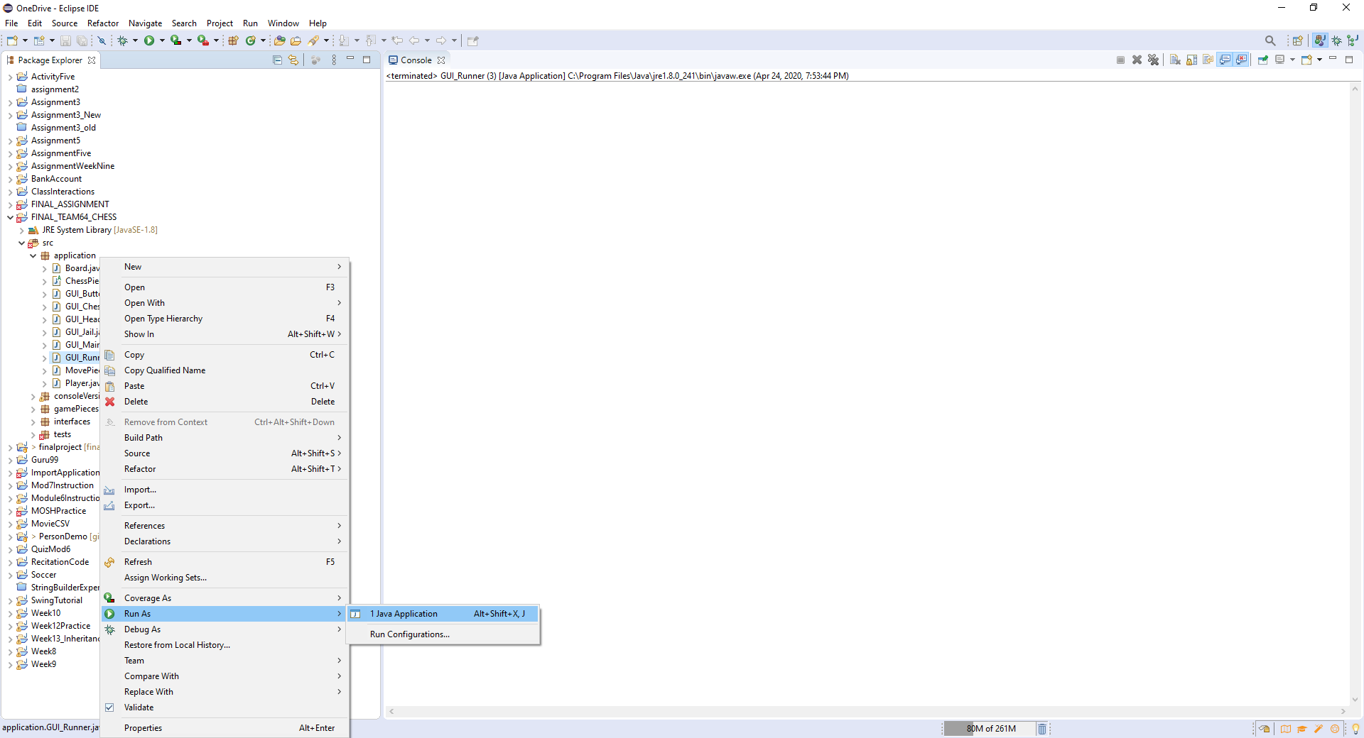
Run as “Java Application” and GUI should launch

Slide 4
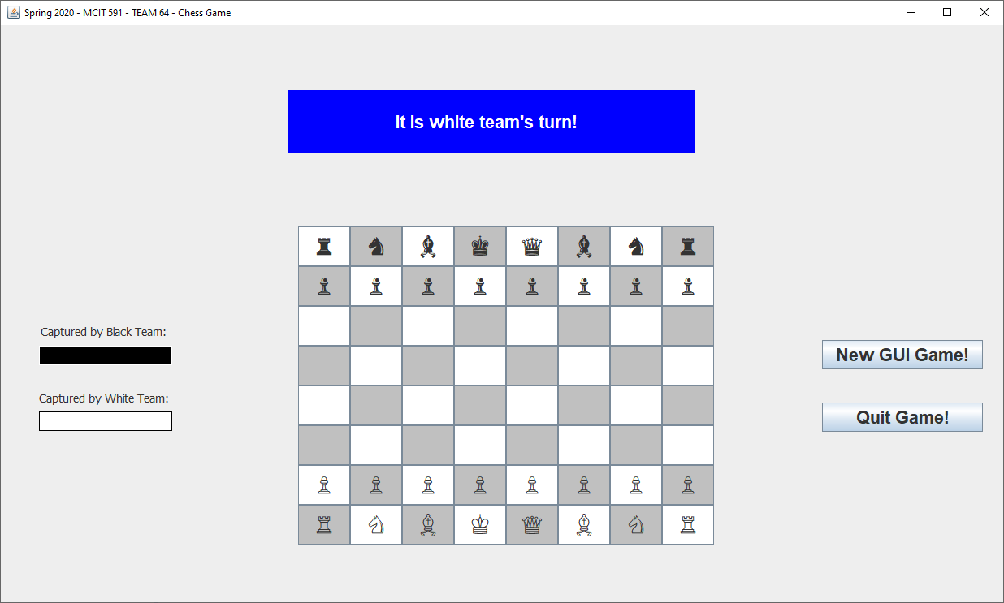
You can play against yourself or hand the mouse to your friend/coworker

Slide 5
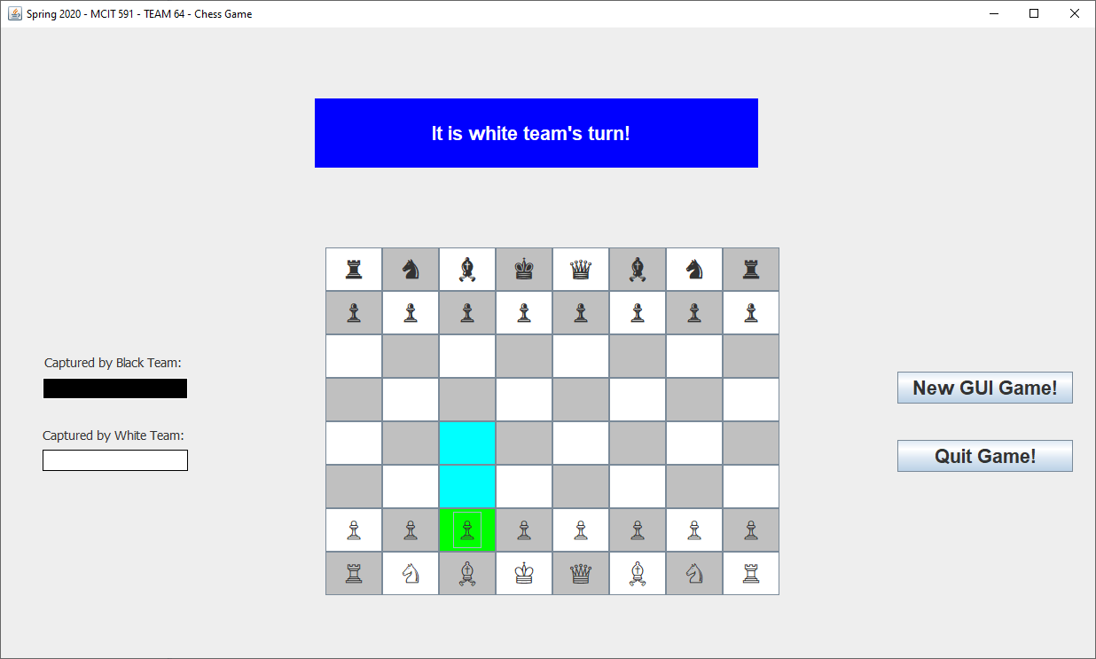
The Frame will tell you which team is currently playing. Once piece is selected, you may move to the positions highlighted.

Slide 6
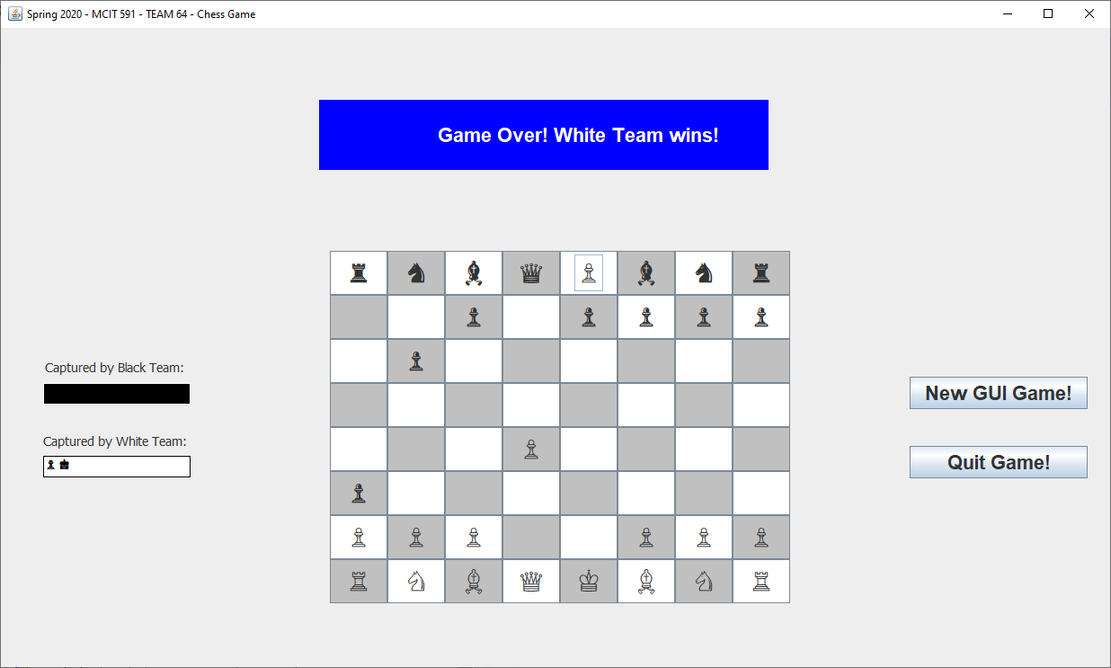
Once the King is captured you may not move any further. select “Quit Game” or start the fun over with “New GUI Game!”

Slide 7
To run the JUnit tests in the tests package, open “BoardTest.java”.
You can see that entire package may have errors if the ”.classpath” has not been added.
To correct this, hover over any of the “@Test” error in “BoardTest.java” and select “Add JUnit 4 library to build path”

Slide 8
Then select “JunitTestSuite.java” and “Run As” “JUnit Test”

Slide 9
By running the “JunitTestSuite.java”, one would be able to run all the tests in the tests package

